Slide 1


Capstone 1: The Fight against malaria …An effort at predicting the impact of malaria
Author: Zack Allen, MD, MBA
Date: 1/18/2018

Slide 2
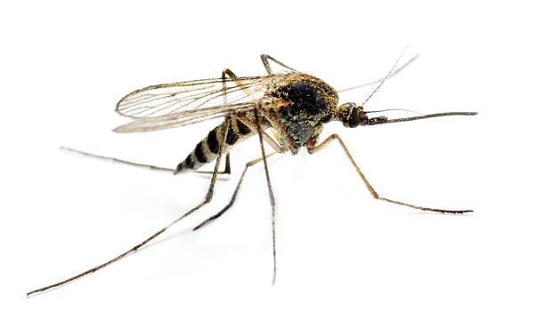
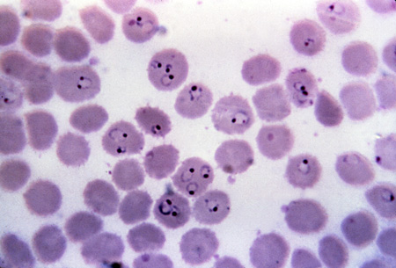
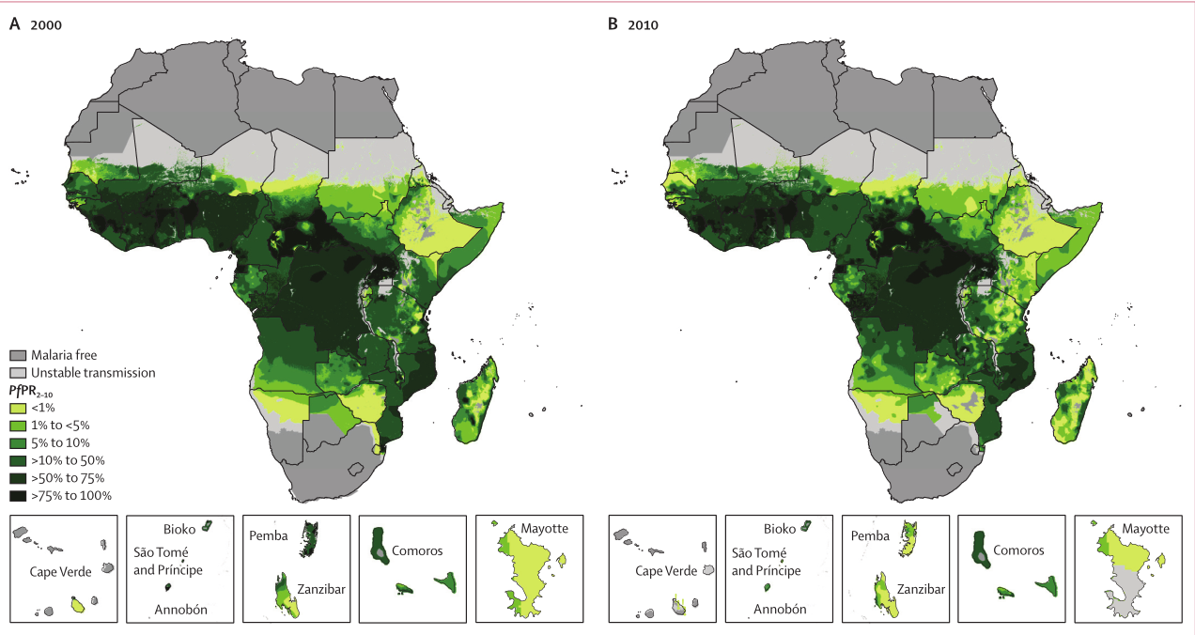
Outline
Intro & Background
Dataset and Data Acquisition
EDA and Findings
Statistical Inference
Machine Learning
Conclusions
Next Steps

Slide 3
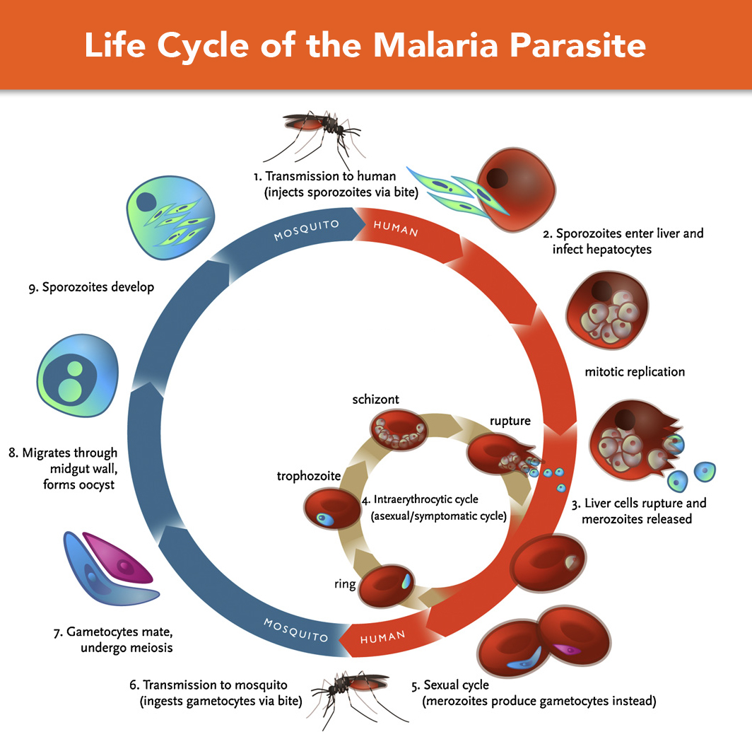
A little background on the topic…
Mosquito born disease
Caused by parasite Plasmodium species
Replicates in the blood stream
Most cases can be treated/prevented with modern medication
Though resistance is a growing concern

Slide 4
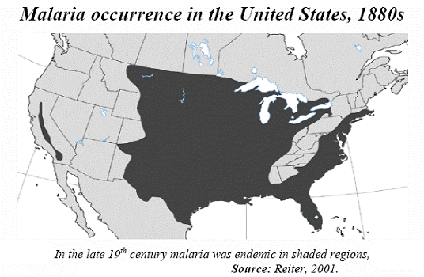
The Problem
Geographically similar regions have large divergence in impact of malaria.
It is difficult to assess true impact of aid efforts especially at scale and in an objective manner.
The ability to accurately anticipate outbreaks has been elusive.

Slide 5
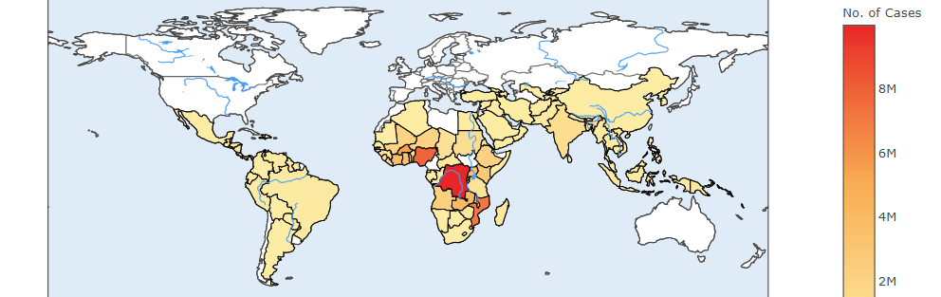
Reported Malaria cases in 2014
The geographic spread of malaria is residing, slowly.

Slide 6
The Goal
Provide a model by which the impact of malaria can be estimated and localized. Thus, allowing more efficient allocation of finite resources.
Assess the effectiveness of aid efforts by tracking and evaluating features of each region and the type of efforts provided e.g. malarial medications and/or insect nets.

Slide 7



Data Acquisition & Wrangling
Data Acquisition:
Kaggle Competition
Information on the distribution of aid efforts
World Health Organization
Statistics on number of cases and mortality
The World Bank
Environmental data
Institute for Health Metrics and Evaluation
Data on the incidence and number of cases
Data Wrangling:
Missing values – removed
Duplicate values – removed
The data is unbalanced i.e. not all countries have entries for all years
Country code was treated as a categorical variable
1023 entries
Data columns (total 15 columns):
Unnamed: 0 1023 non-null int64
year 1023 non-null int64
country_code 1023 non-null object
reported_cases 1023 non-null float64
region_x 1023 non-null object
reported_deaths 1023 non-null float64
rainfall 1023 non-null float64
temperature 1023 non-null float64
population 1023 non-null float64
percent_agg 1023 non-null float64
percent_urb 1023 non-null float64
gdp_per_cap 1023 non-null float64
country_name 1023 non-null object
pop_density 1023 non-null float64
incidence 1023 non-null float64

Slide 8
Data Challenges & Concerns
Inconsistency in reported numbers between institutions.
Difficulties in obtaining accurate and timely data from regions most affected.
Fluidity of borders e.g. people infected in one region and developing symptoms in another.

Slide 9
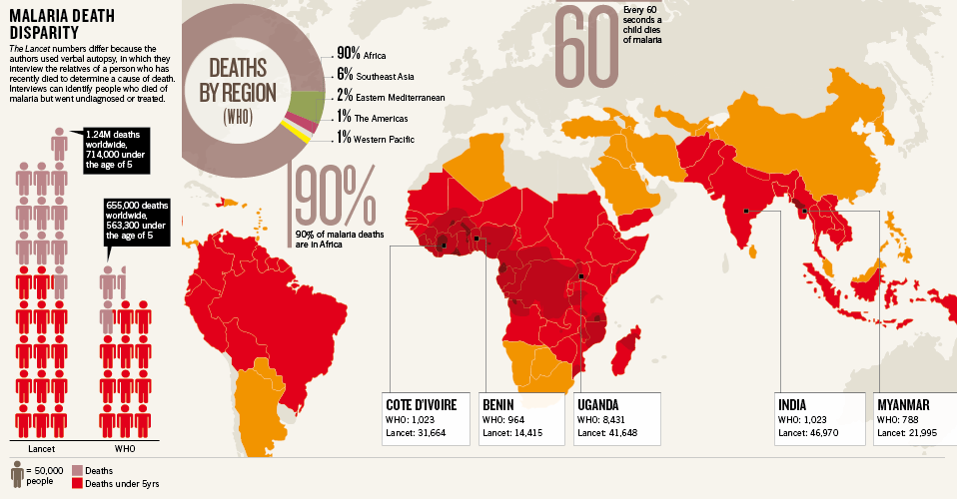

Inconsistent numbers …but overall trends remain

Slide 10
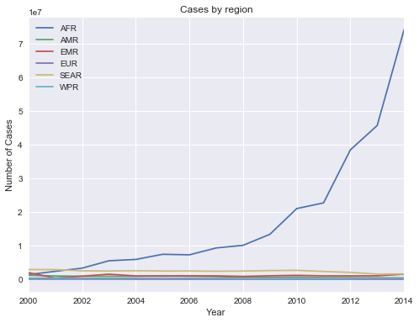
Africa
Greatest impact is in Africa

Slide 11
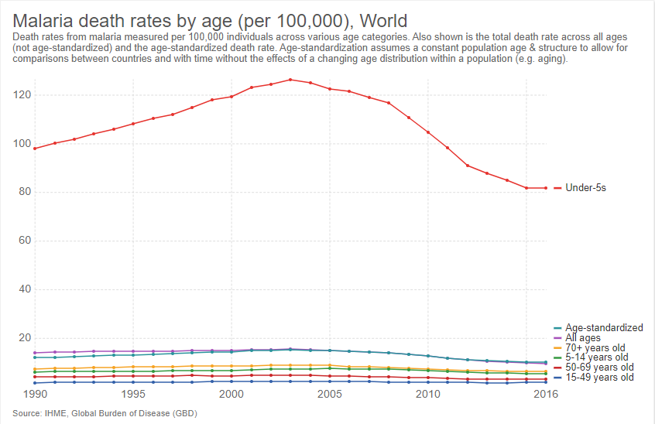
Children under 5

Slide 12
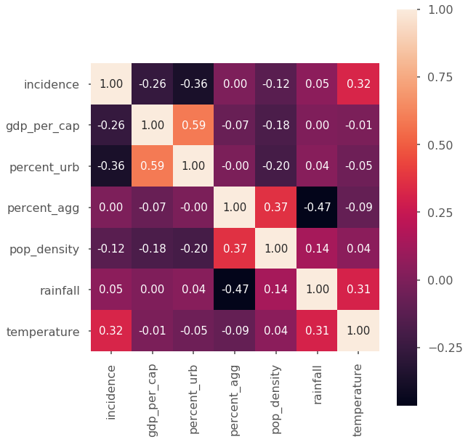
Looking at the Features
Correlations
Incidence of malaria
GDP per capita
Percent Urban
Percent of the total population living in an urban environment.
Percent Agricultural land
Percent of the countries total land area that is used for agriculture. A marker of those with an outdoor occupation.
Population Density
Rainfall
Scaled to a yearly average
Temperature
Scaled to a yearly average

Slide 13
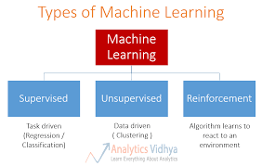
Machine Learning
Approach:
Test algorithms: Linear Regression, Bayesian Ridge, Random Forrest.
Perform feature analysis using Random Forrest and tune parameters as necessary.
Examine models and identify the best overall model.
Use models to predict incidence and examine results.

Slide 14
Machine learning: model Performance
 | Train/Test Split | Rounds of Validation | Average Model Score (1.0 is best)
Random Forrest Regression | Yes | 5 | 0.68
Bayesian Ridge Regression | Yes | 5 | 0.66
Linear Regression | Yes | 5 | 0.60

Slide 15
Training Structure
2000 - 2009 | 2010 | 2011 | 2012 | 2013 | 2014
Train | Test
Train |  | Test
Train |  |  | Test
Train |  |  |  | Test
Train |  |  |  |  | Test

Slide 16
Single year anomaly in 2013 predictions
We can see abnormally low accuracy for all models on the 2013 test data.
Model | 2010 | 2011 | 2012 | 2013 | 2014
Random Forrest Regression | 0.90 | 0.85 | 0.95 | -0.19 | 0.93
Bayesian Ridge Regression | 0.83 | 0.80 | 0.85 | -0.002 | 0.82
Linear Regression | 0.72 | 0.58 | 0.84 | 0.07 | 0.79

Slide 17
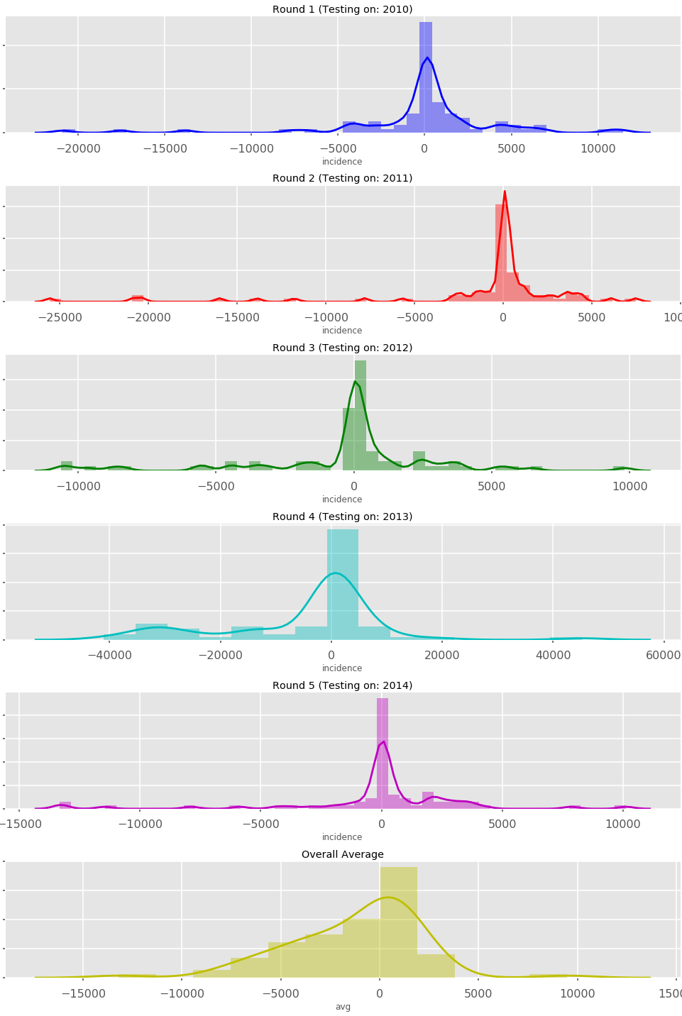
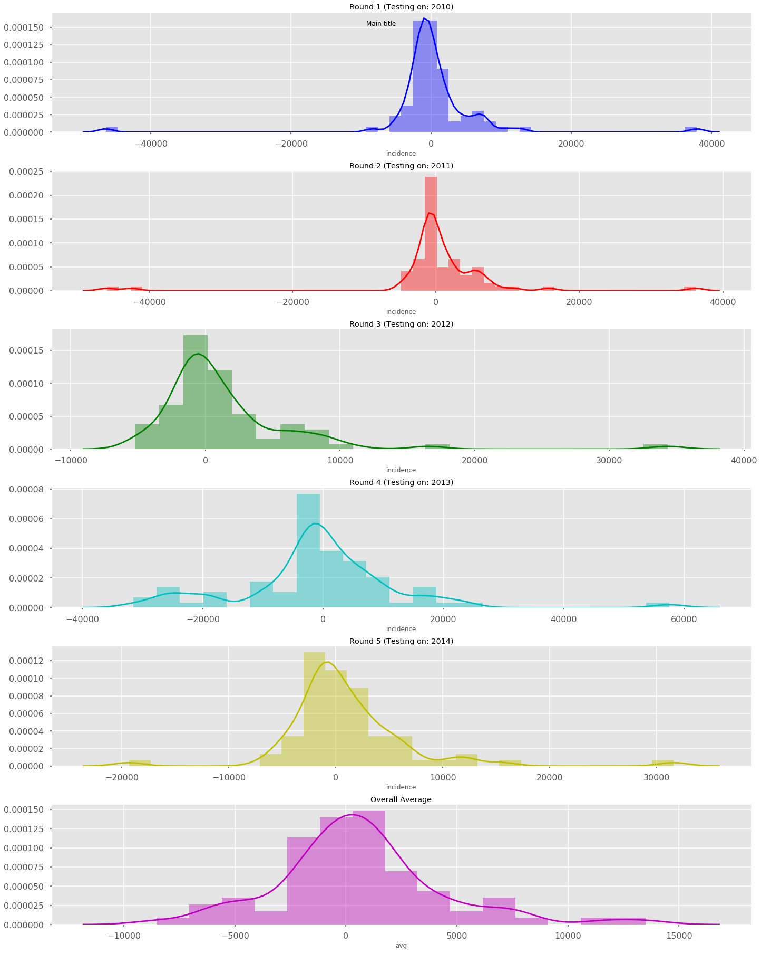
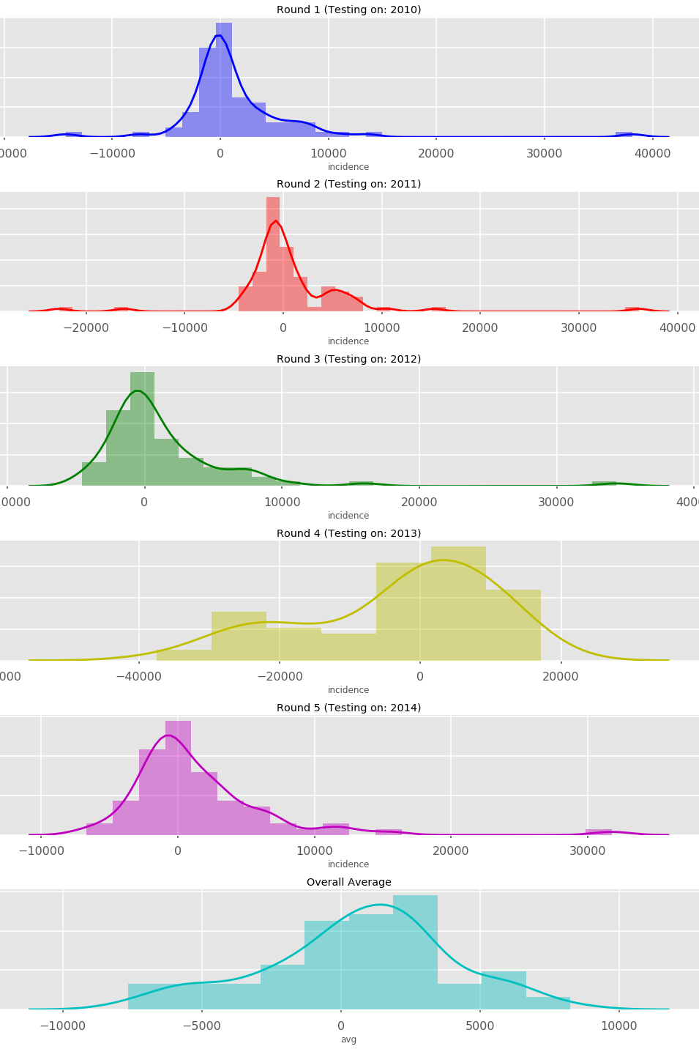
Distribution of Residuals
Round 1
RF
Linear
Bayes
Round 2
Round 3
Round 4
Round 5
Average

Slide 18
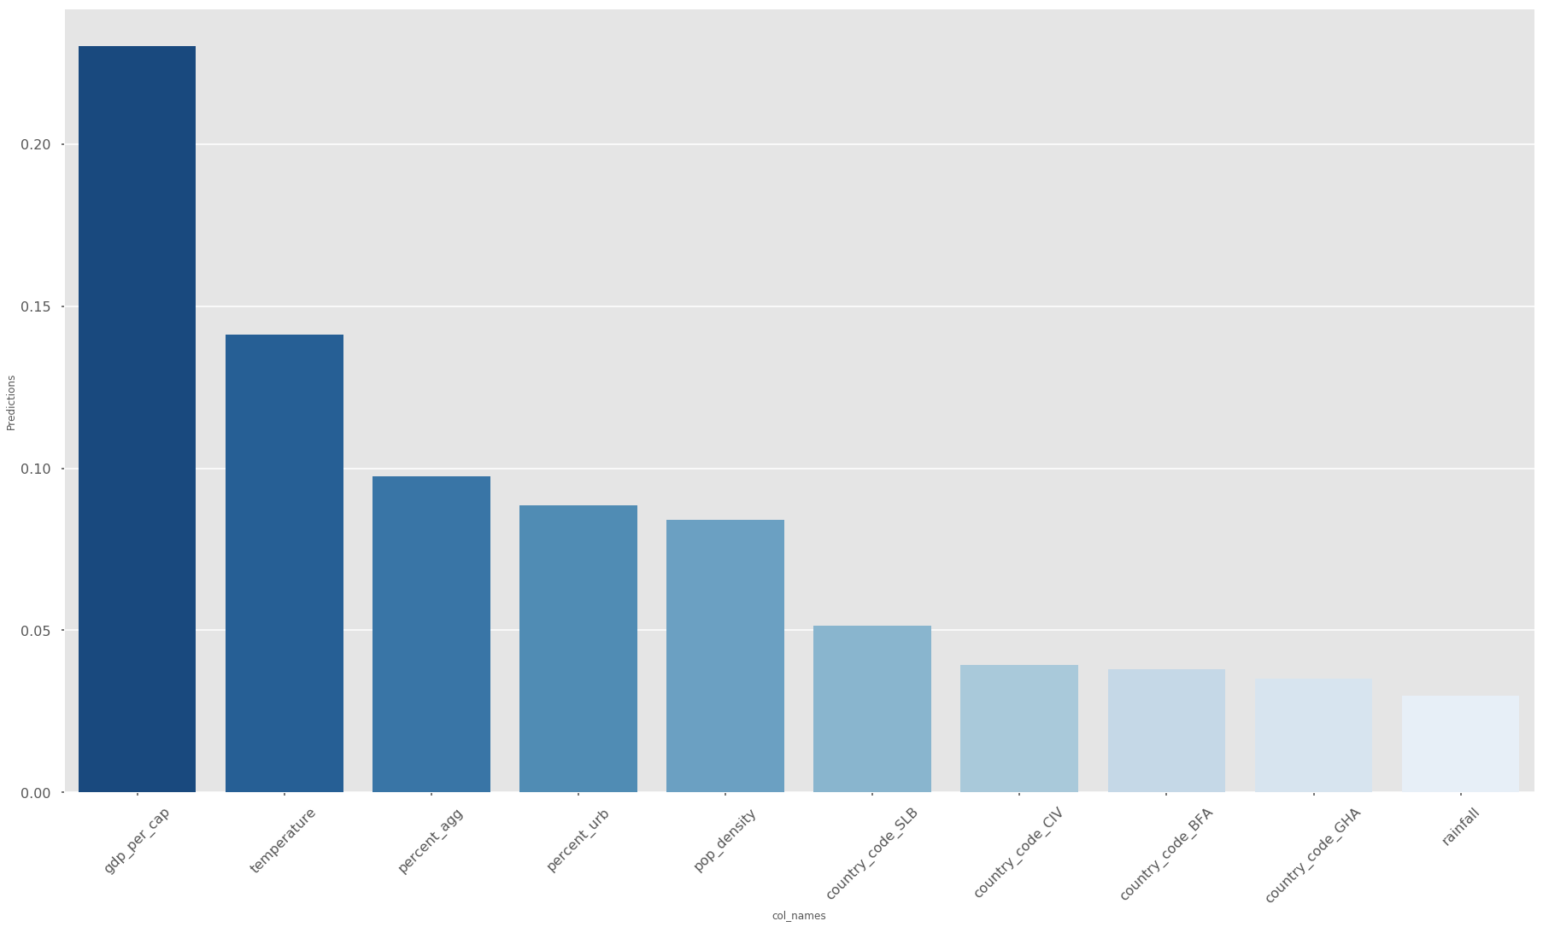
Machine learning: Feature analysis
GDP per capita is the most influential feature of those examined.
Features in order of importance:
GDP per capita
Temperature
Percent agricultural land
Percent urban population
Population density
Country code
Relative importance of features:

Slide 19
Key Findings
The Random Forrest model provided the most consistent accuracy.
GDP per capita was the most influential of human factors and temperature was the most influential of environmental factors.
In 4 out of 5 years the tested models were all able to give accurate (0.85 or greater for RF) and potentially usable prediction of the incidence from the given data.

Slide 20
Limitations
Use of country and yearly level data limiting resolution.
Need access to monthly and county/province level data.
Use of substitute markers e.g. percent agricultural land.
Probably more accurate to use actual numbers (estimates) of those with an outdoor occupation.
Limited number of data points approximately 1000 entries used.
Increasing the number of years with complete data either by better data collection or imputing with the average could provide more robust results.

Slide 21
Recommendations & future improvements
Recommendations:
A ML based tool to predict the impact of malaria and where resources should be allocated appears feasible.
Increasing resolution of data to a county/province level would allow use of additional factors such as elevation.
Train the model on a greater number years worth of data, especially outlier years e.g. 2013.
Future improvements:
Access to real/near-real time data to integrate into an active model would increase usefulness.
Use of entirely new features such as satellite data and mosquito species.

Slide 22
Resources
https://www.kaggle.com/teajay/the-fight-against-malaria
http://www.who.int/en/
http://www.worldbank.org/

